Slide 1
Chapter 7
Improving Web Design with New Page Layouts

Slide 2
Chapter Objectives
You will have mastered the material in this chapter when you can:
Describe and use article, aside, and section elements
Describe and use figure and figcaption elements
Describe and use the CSS grid layout
Describe and use the opacity property
Describe and use the box sizing property
Describe and use the text shadow property

Slide 3
Chapter Objectives (continued)
Describe and use the box shadow property
Insert and style figure and figcaption elements
Insert a section element
Insert and style an article element
Insert and style an aside element
Describe and add a favicon to a webpage

Slide 4
Introduction
Web design involves a daily pursuit of perfection in layout, function, and efficiency
You must constantly re-evaluate content and design and apply new technologies and innovations to keep audiences engaged and customers elated
HTML 5 provides tools for improving webpage design, including semantic elements for specific types of content

Slide 5
Project — Use HTML 5 Structural Elements to Redesign a Website
Roadmap
MODIFY the HOME PAGE
STYLE the HOME PAGE elements
MODIFY the ABOUT US PAGE
CREATE AND STYLE the NUTRITION PAGE elements
ADD a FAVICON

Slide 6
Using HTML 5 Semantic Elements
HTML 5 semantic elements are a set of starting and ending HTML tags
Provide a standard naming convention for webpage content, making webpages more universal, accessible, and meaningful to search engines

Slide 7
Article Element
A complete, self-contained composition in a document, page, application, or site
Independently distributable or reusable, e.g. in syndication
Start and end tags of article elements are <article> and </article>
Content placed between these tags will appear on a webpage as part of the article element

Slide 8
Article Element (continued 1)
Articles may be nested within other HTML elements
Such as the main element, section element, or other article elements
Articles are commonly used to contain news articles, blog and forum posts, or comments

Slide 9
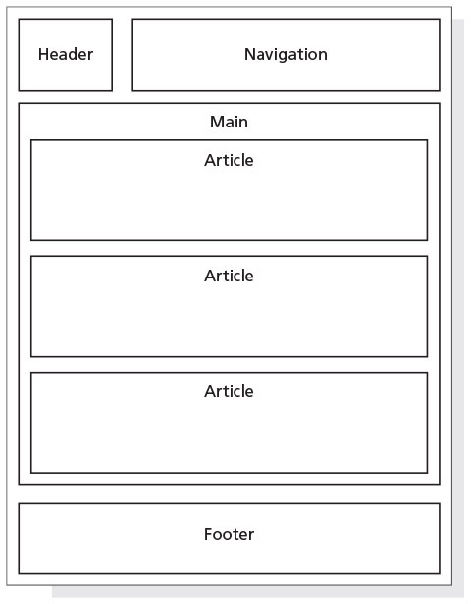
Article Element (continued 2)
Figure 7–4

Slide 10
Aside Element
Used as a sidebar that contains additional information about a particular item mentioned within another element
If an article on a webpage contains a recipe and a list of ingredients, one could include an aside element with more information about one of the key ingredients, such as its origin or where to purchase it
Can be nested within article elements or within main or section elements

Slide 11
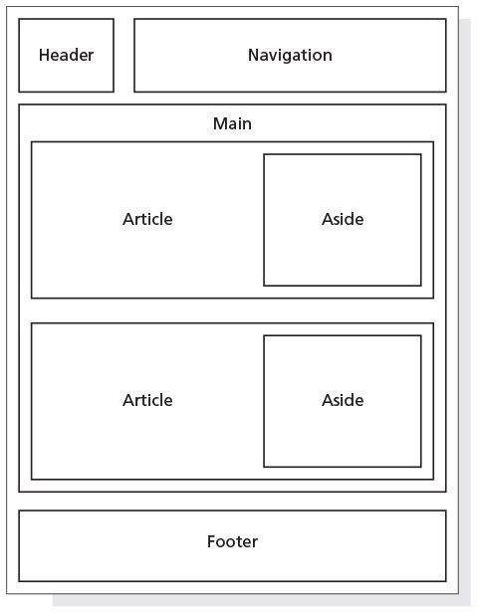
Aside Element (continued)
Figure 7–6

Slide 12
Section Element
Represents a generic section of a document or application
A section is a thematic grouping of content
The theme of each section should be identified, typically by a heading
Not a generic container element
A general rule is that the section element is appropriate only if the element’s contents would be listed explicitly in the document’s outline

Slide 13
Section Element (continued 1)
The following is an example of a several section elements nested within an article element
<article>
<h1>Tutorials: Cooking Basics</h1>
<p>Watch our tutorials to learn the basics of good cooking.</p>
<section>
<h1>Tutorial 1</h1>
<p>Assembling basic kitchen tools.</p>
</section>
…
</article>

Slide 14
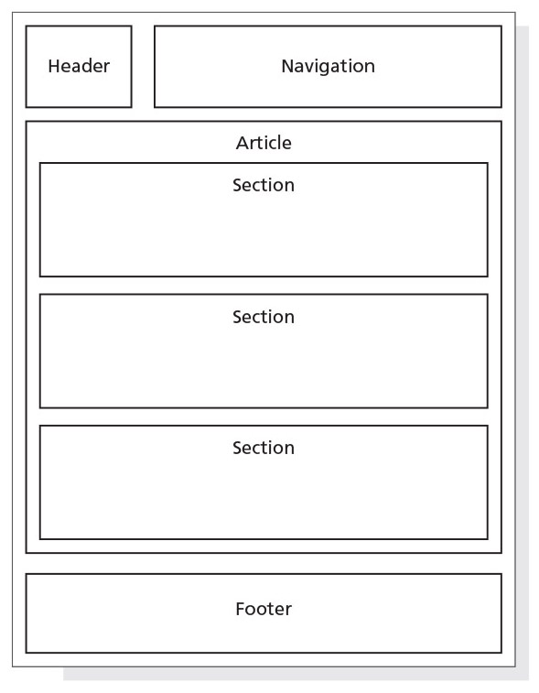
Section Element (continued 2)
Figure 7–8

Slide 15
Figure and Figure Caption Elements
The figure element is used to group content, such as illustrations, diagrams, and photos
Represents some flow content that is self-contained and is typically referenced as a single unit from the main flow of the document
Can contain one or more img elements
May contain an optional figure caption element, which is used to provide a caption for the figure element
Start and end tags of the figure caption element are <figcaption> and </figcaption>

Slide 16
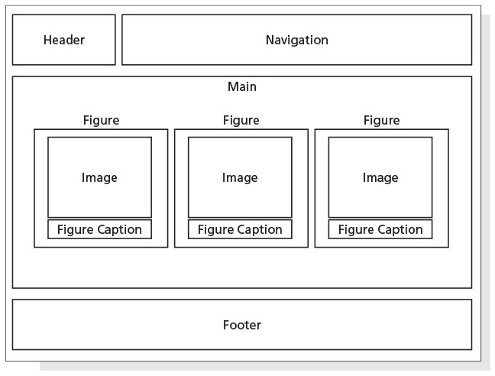
Figure and Figure Caption Elements (continued)
Figure 7–10

Slide 17
Improving Design with CSS
CSS grid layout
Newer webpage design model used to create a single or multiple-column layout by controlling the size and position of boxes of content on a webpage
Opacity
Specifies the amount of transparency of an element

Slide 18
Improving Design with CSS (continued)
CSS shadows
Box-shadow applies a shadow to an element
Text-shadow property applies a shadow to text
CSS box-sizing
Allows any specified padding or border to be included within the element’s total size

Slide 19
Redesigning the Home Page
Home page can be improved by adding figure and figcaption elements with pictures
Provide more visual content for potential clients

Slide 20
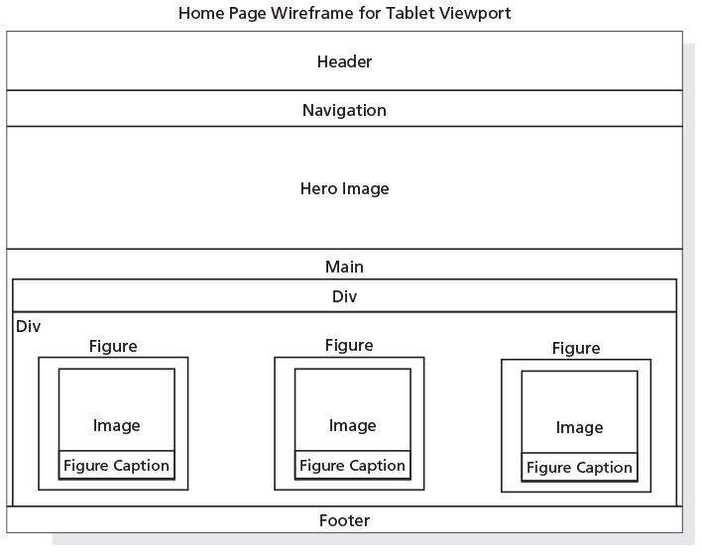
Redesigning the Home Page (continued 1)
Figure 7–12

Slide 21
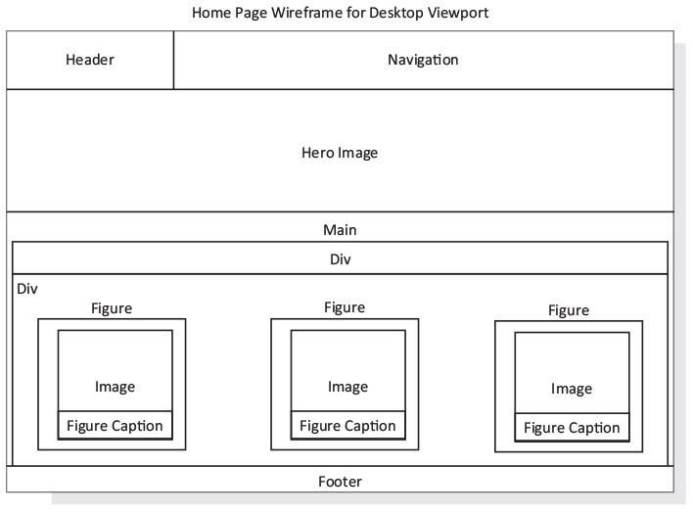
Redesigning the Home Page (continued 2)
Figure 7–13

Slide 22
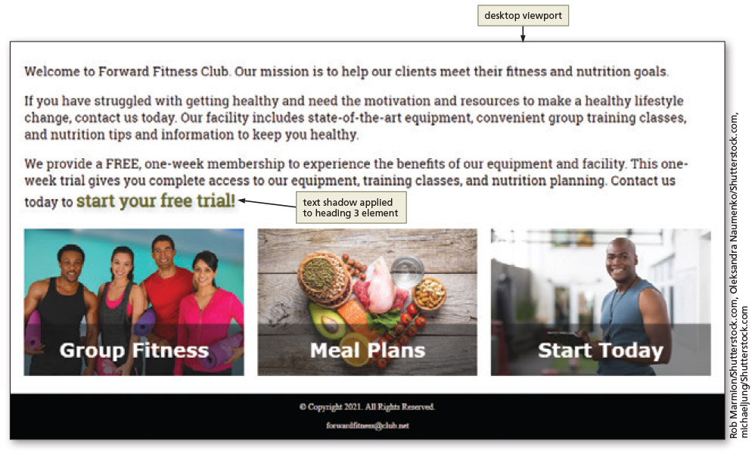
Redesigning the Home Page (continued 3)
Figure 7–38

Slide 23
Creating the Nutrition Page
The Nutrition page provides tips for good nutrition, guidelines for a healthy diet, and a featured recipe of the week
The template.html file is used to create the new page
CSS grid spans
A style rule for the class is created that spans the element across three columns

Slide 24
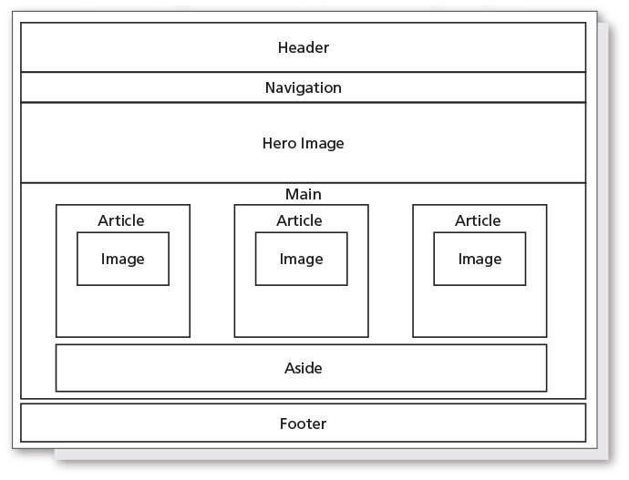
Creating the Nutrition Page (continued 1)
Figure 7–42

Slide 25
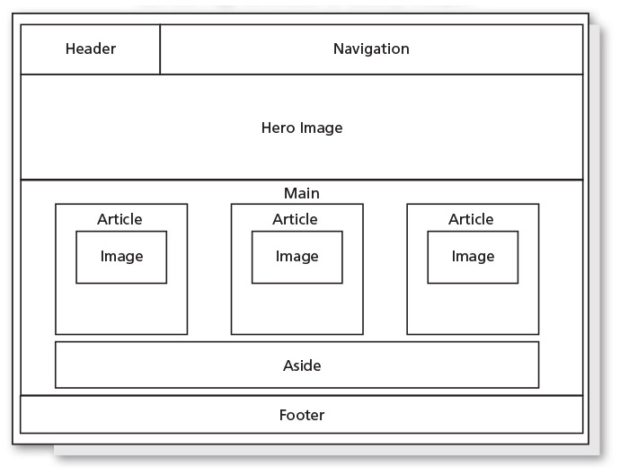
Creating the Nutrition Page (continued 2)
Figure 7–43

Slide 26
Creating the Nutrition Page (continued 3)
Structural pseudo-class, nth-of-type()
Used to select specific elements within a parent element
Example: if you have a table with 20 rows, you may want to apply a different background color to all odd or all even rows
p:nth-of-type(odd) {
background-color: #ccc;
}

Slide 27
Adding a Favicon
Small image that appears on the browser tab that represents the business
Might be a logo or another graphic that identifies the business brand
Helps improve search engine optimization
Can be PNG, GIF, or ICO file
Image sizes are based upon the favicon’s use

Slide 28
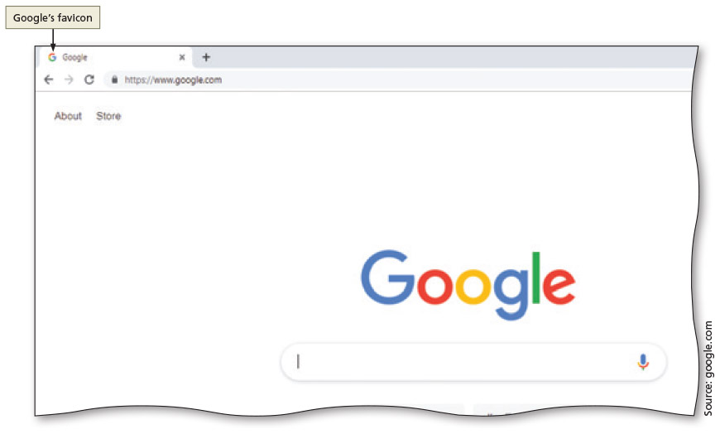
Adding a Favicon (continued 1)
Figure 7–65

Slide 29
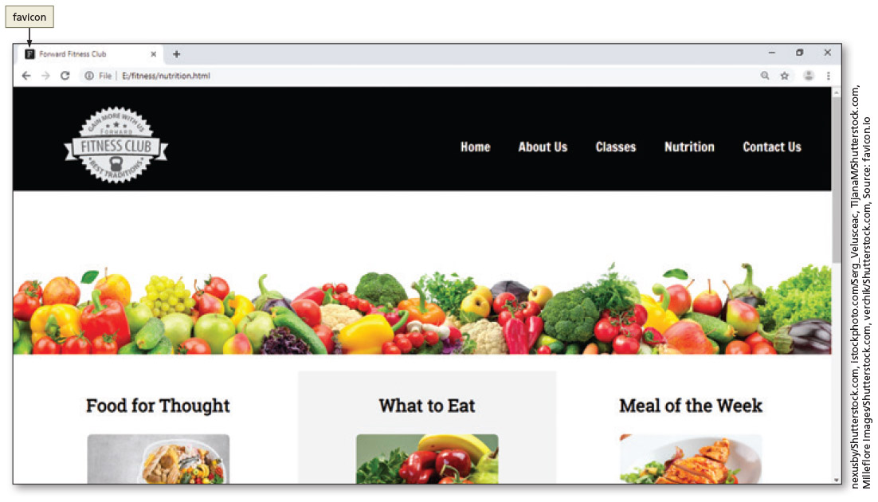
Adding a Favicon (continued 2)
Figure 7–68

Slide 30
Chapter Summary
In this chapter, you learned how to:
Use the HTML 5 figure, figcaption, section, article, and aside semantic elements
Add these elements to the webpages in the website
Create and modify style rules in the style sheet to format the new elements and adapt to the website design
Use a CSS grid layout to create multiple columns
Create style rules to add opacity, box shadows, and text shadows
Add a favicon to a website

